Slide 1
Find()

Slide 2
Find() syntax
db.collectionName.find();

Slide 3
Find() syntax
db.collectionName.find(
{filterConditions},
{projections}
);
Documents to include
Attributes to include

Slide 4
Find() syntax
db.collectionName.find(
{filterConditions},
{projections}
).sort({sortCondition});

Slide 5
Find() syntax
db.collectionName.find(
{filterConditions},
{projections}
).sort({sortCondition})
.limit(RowstoReturn);

Slide 6
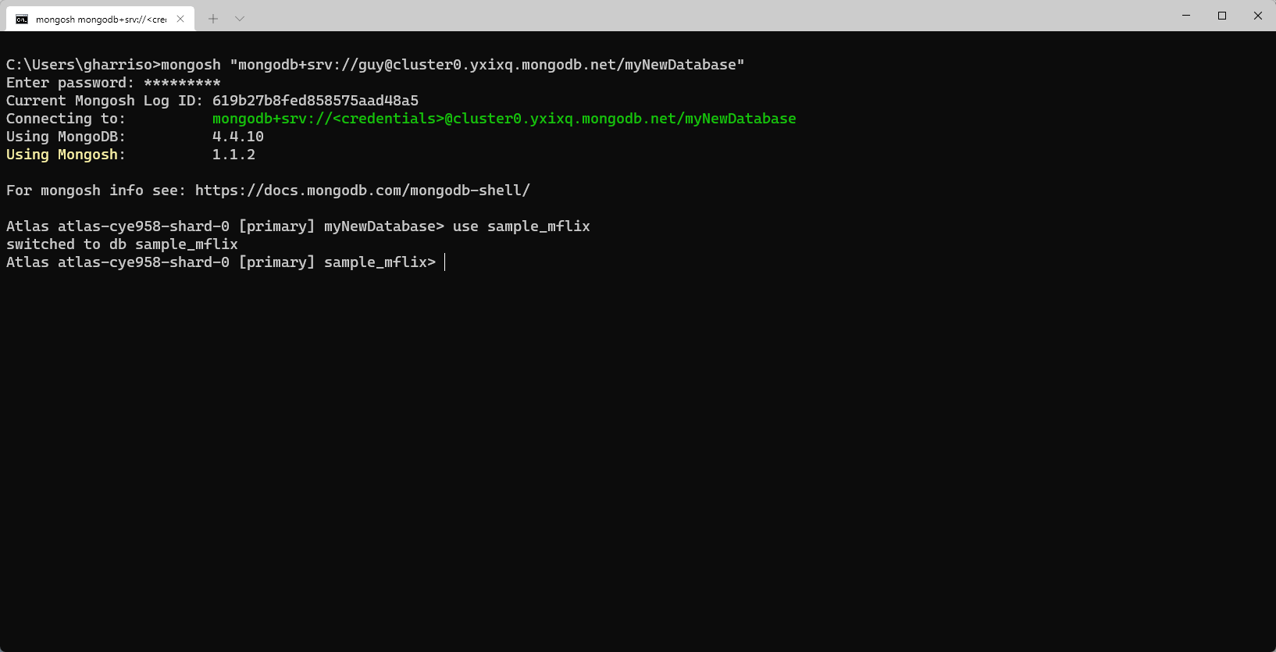

Slide 7
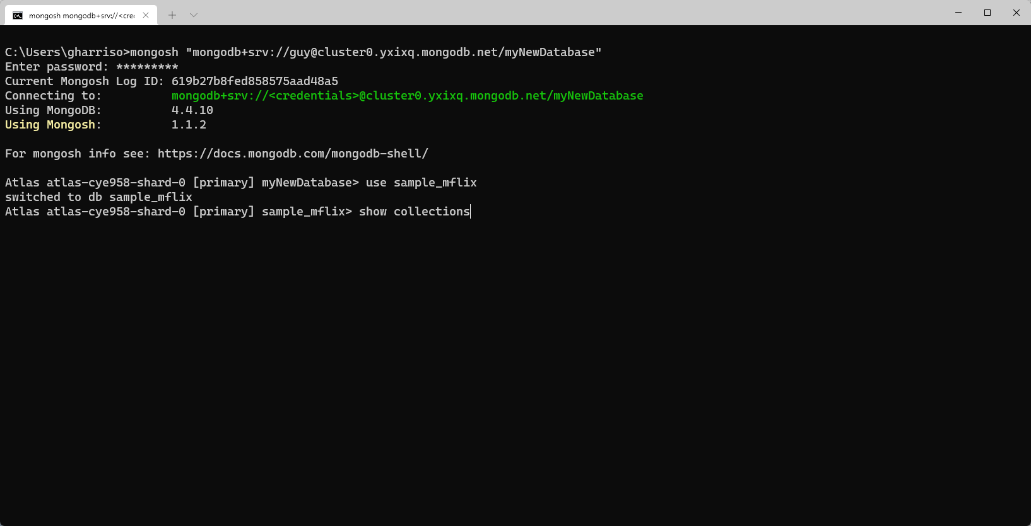

Slide 8
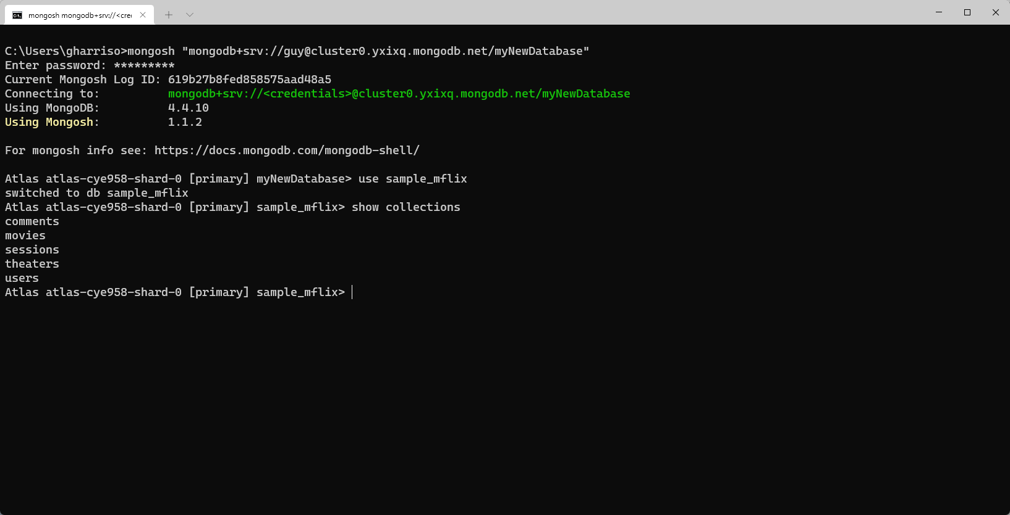

Slide 9
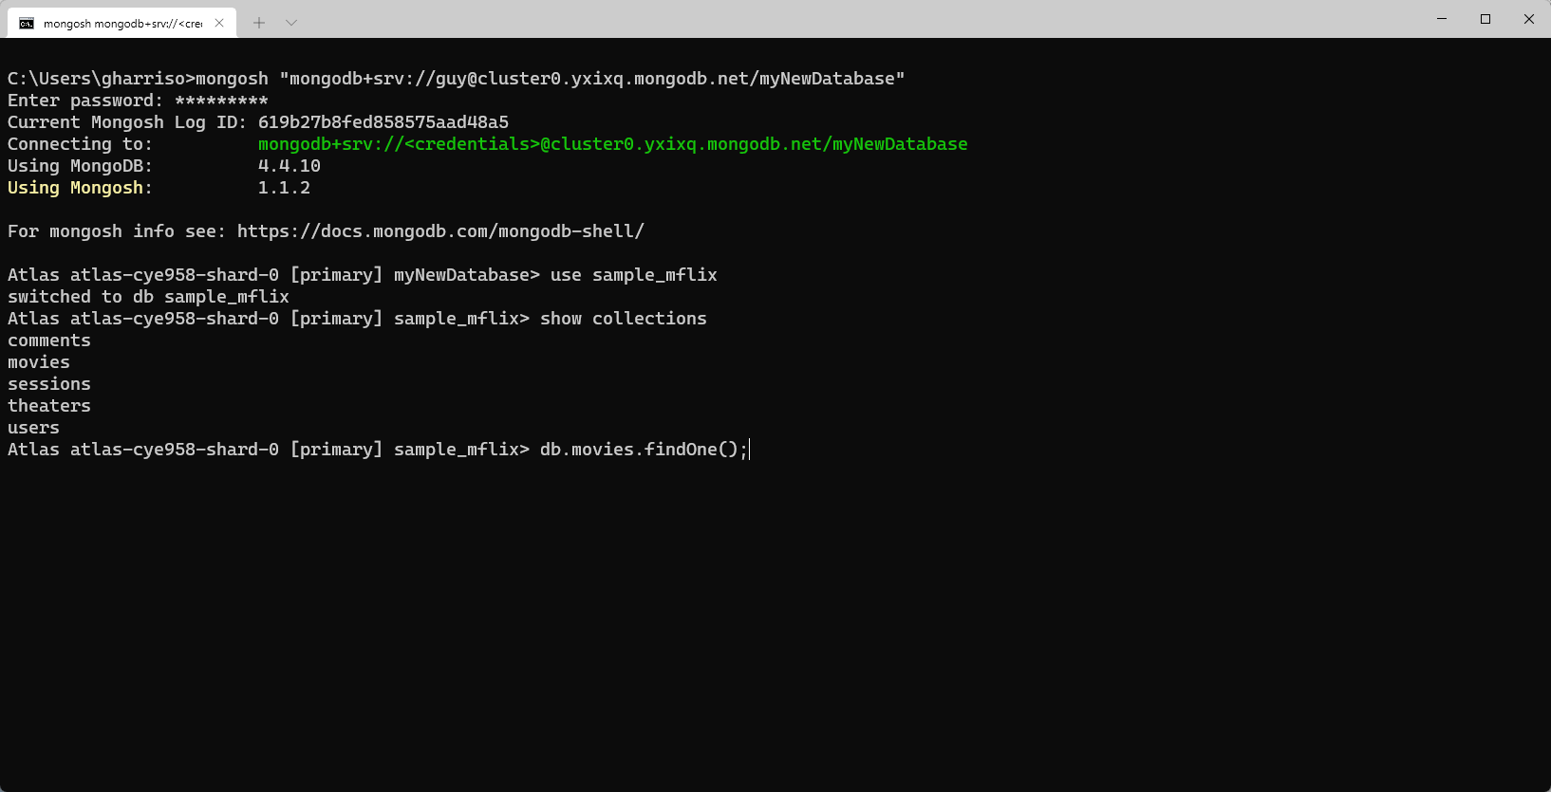

Slide 10
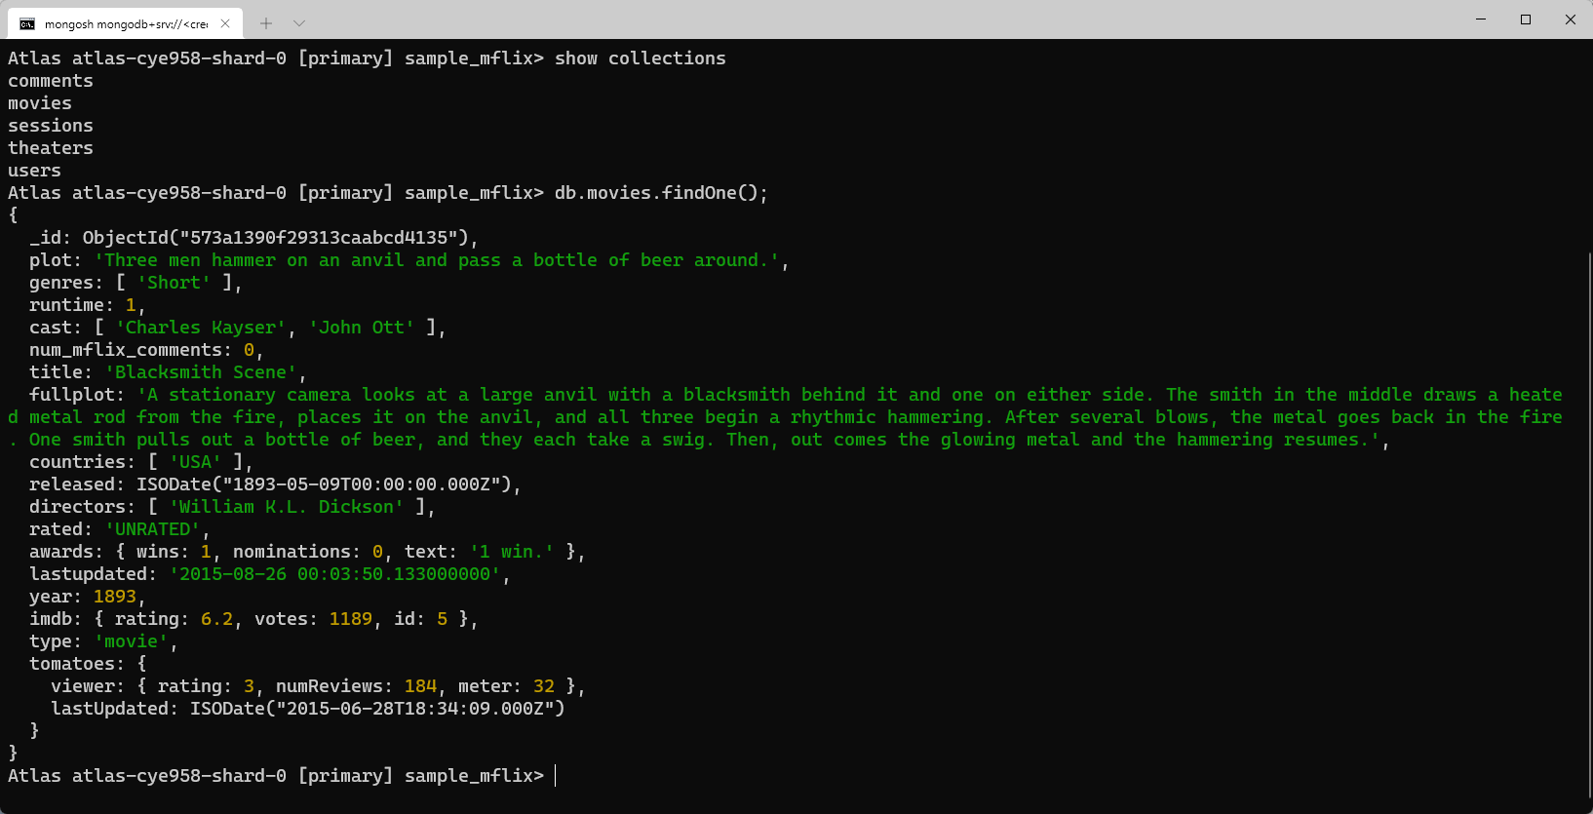

Slide 11
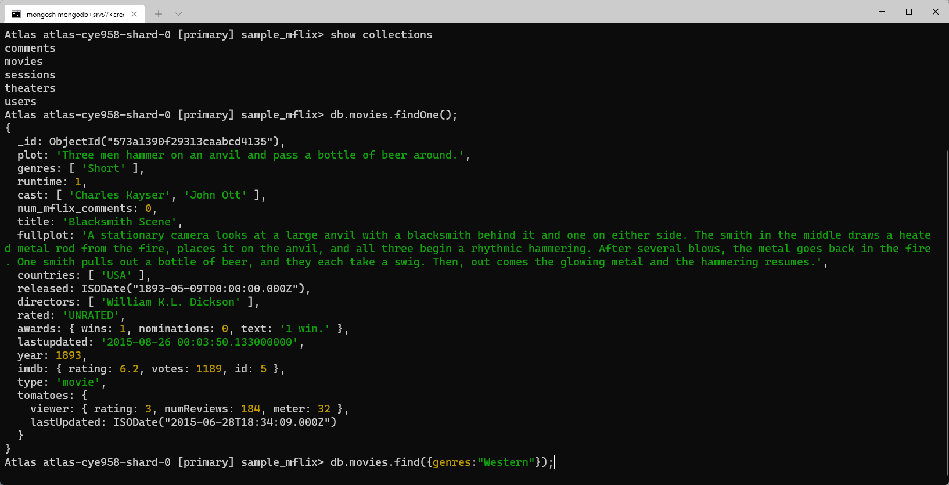

Slide 12
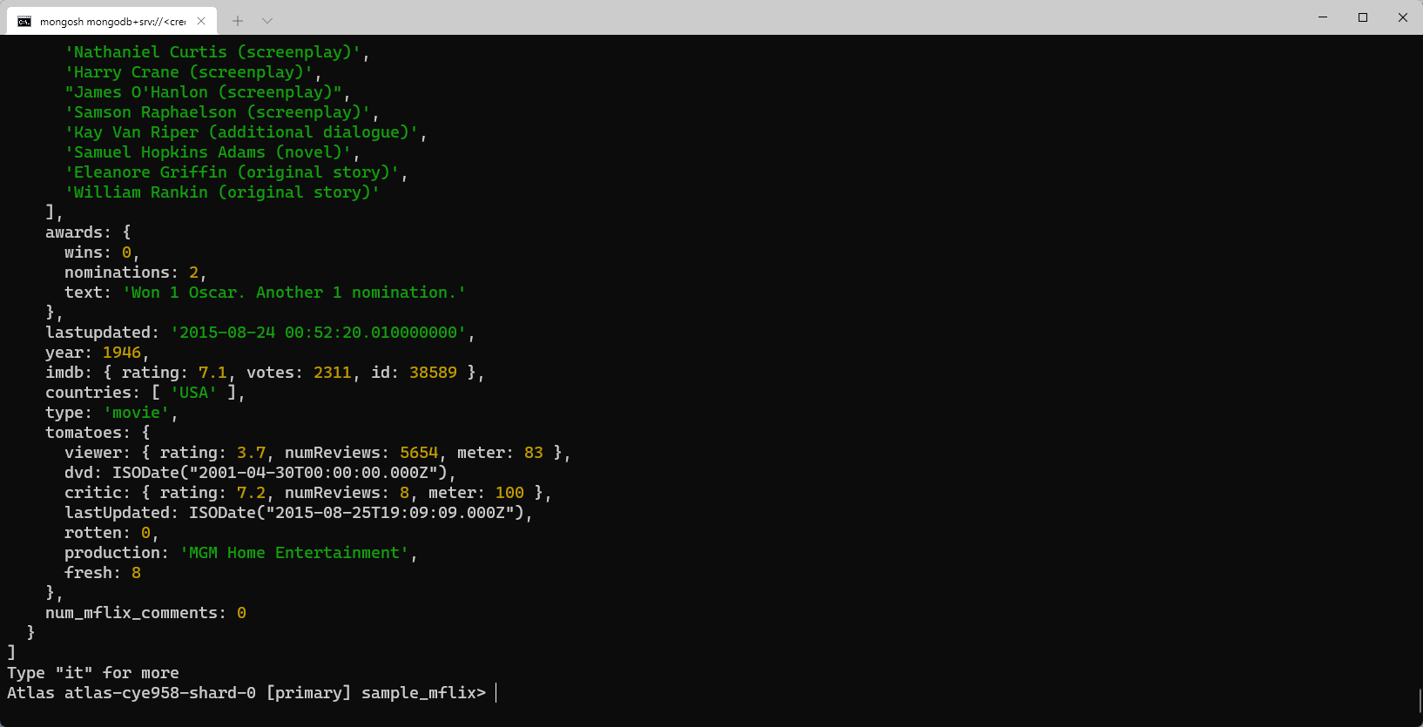

Slide 13
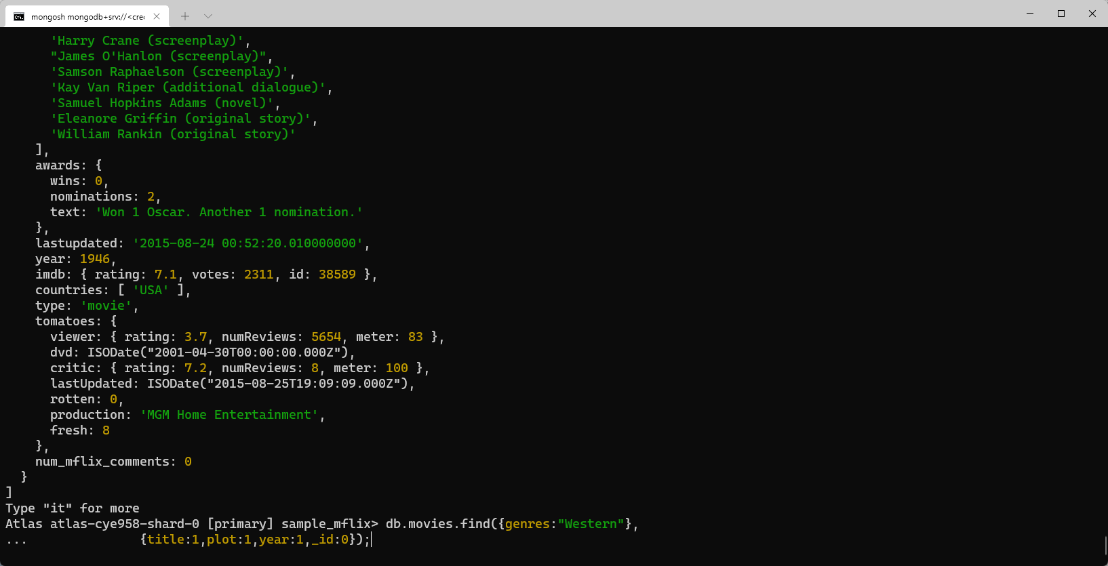

Slide 14
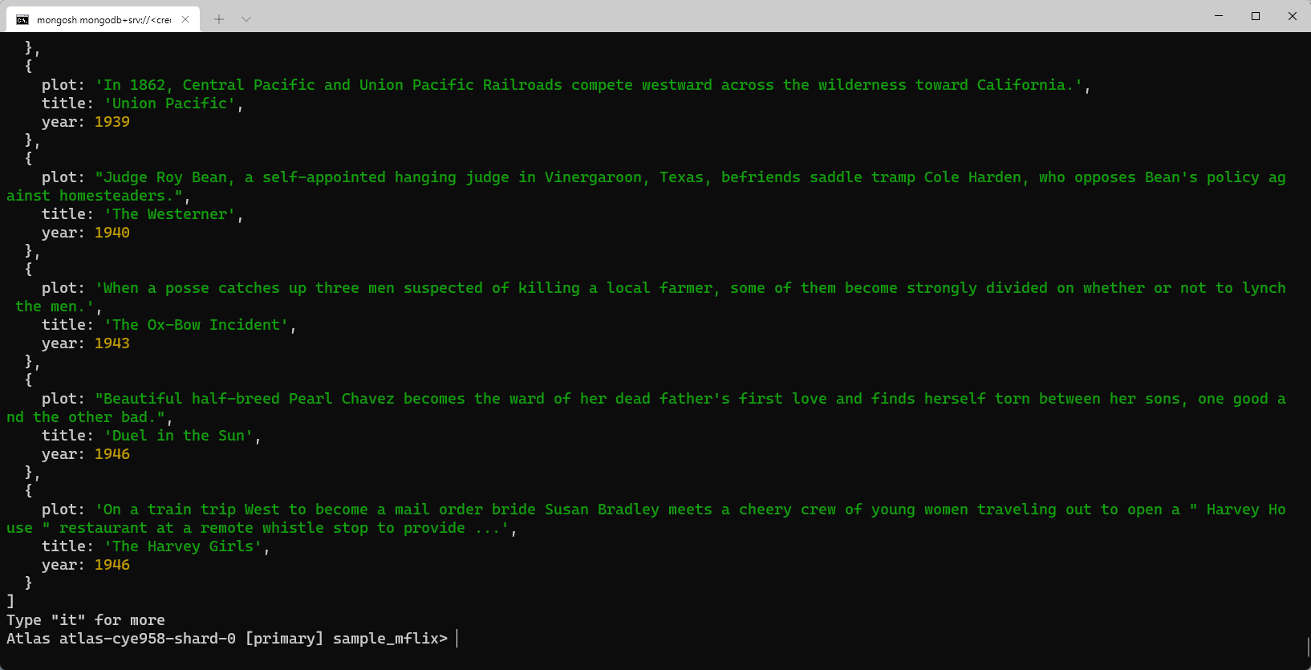

Slide 15
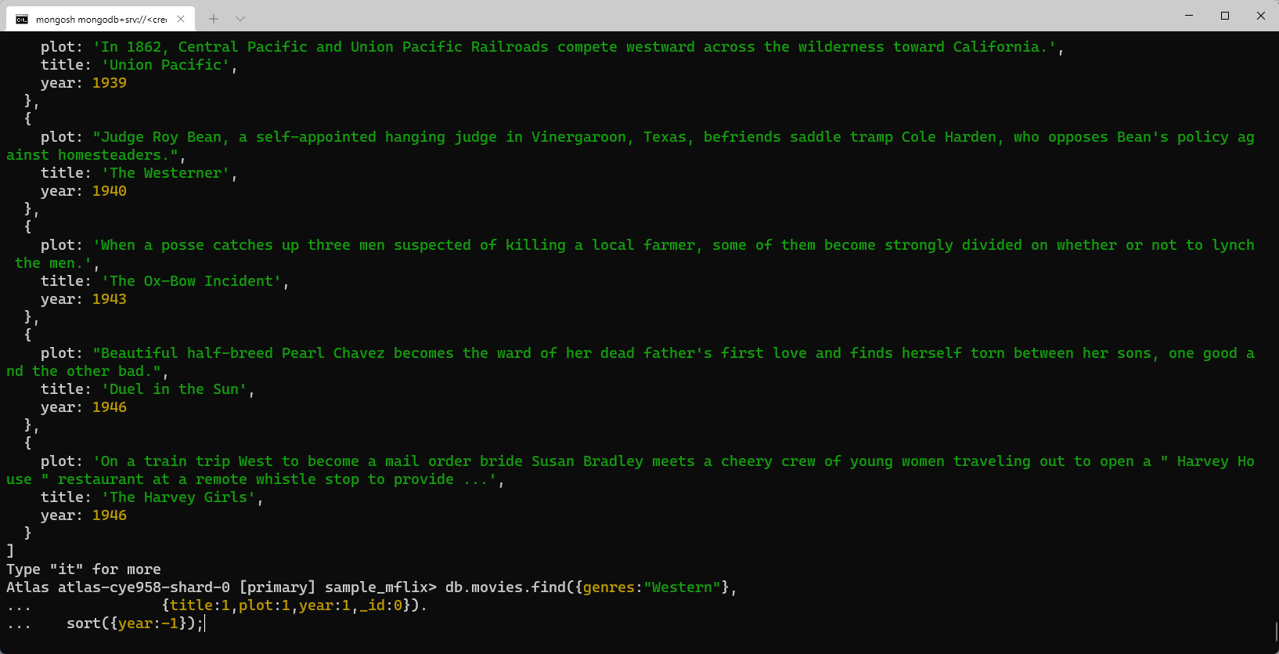

Slide 16
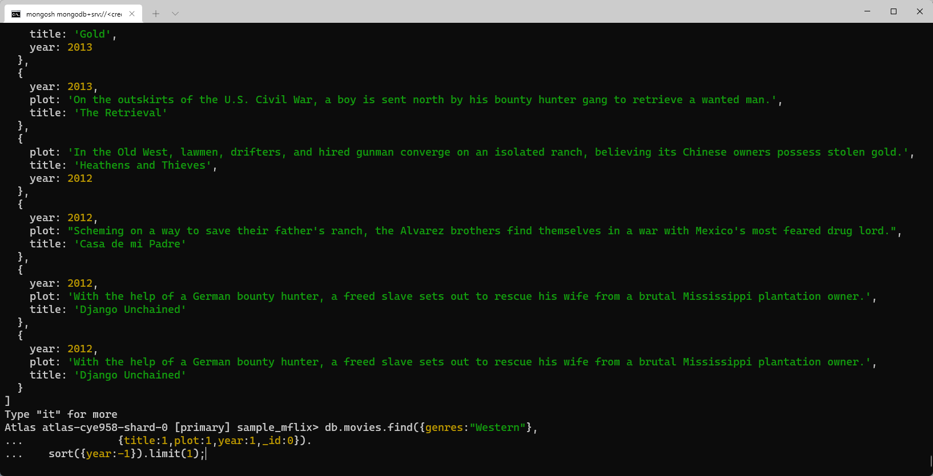

Slide 17
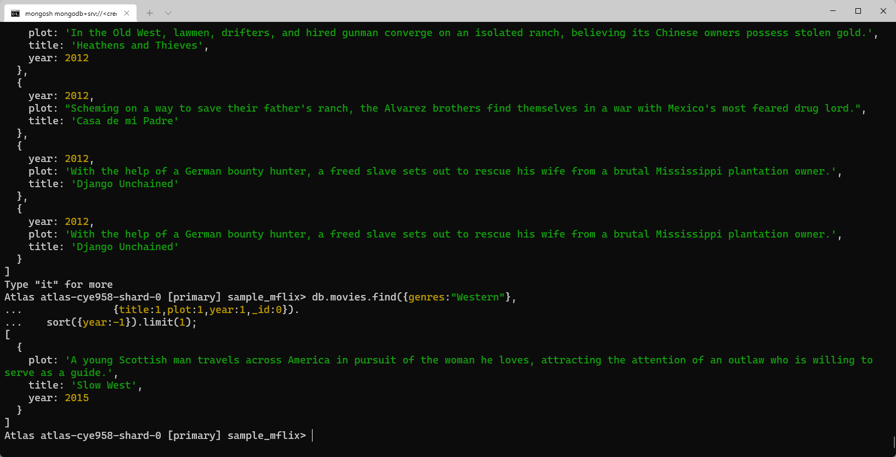

Slide 18
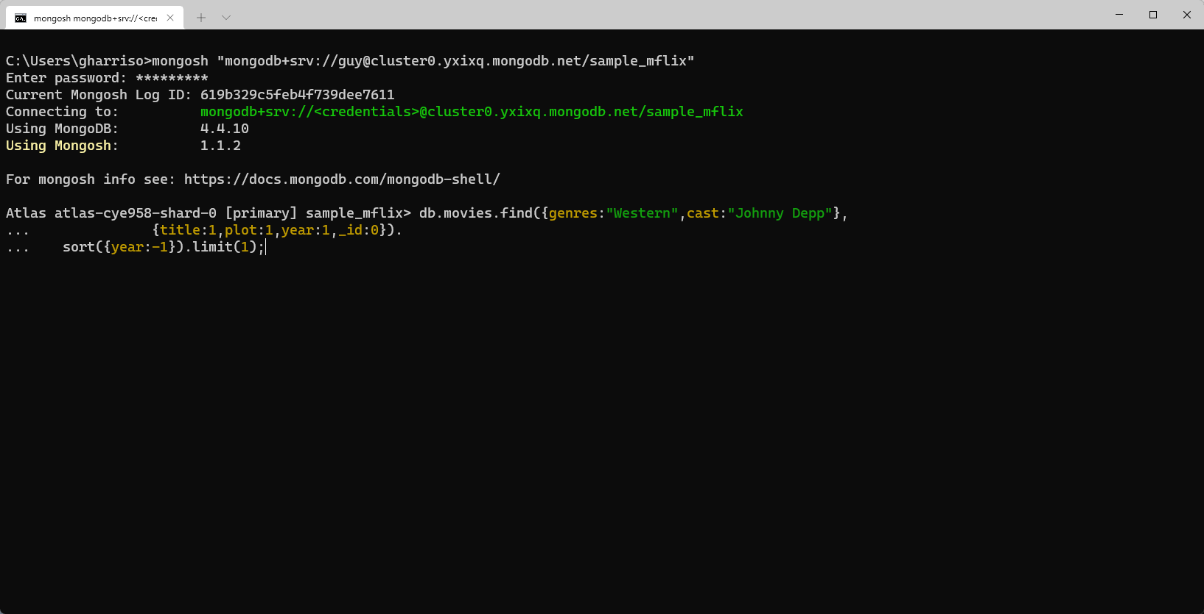
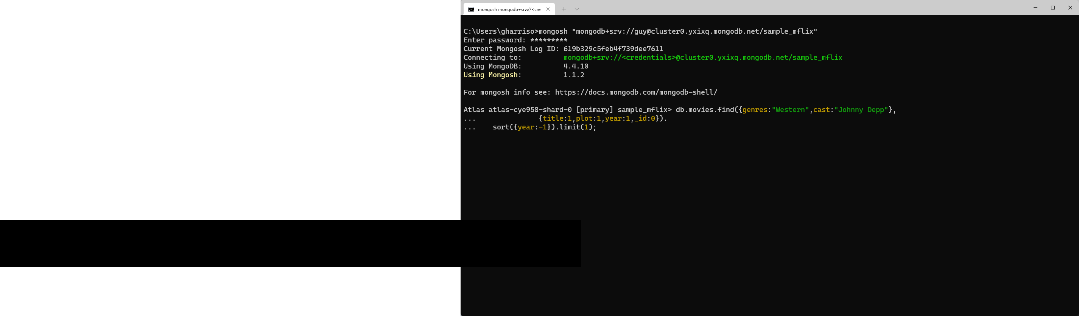

Slide 19
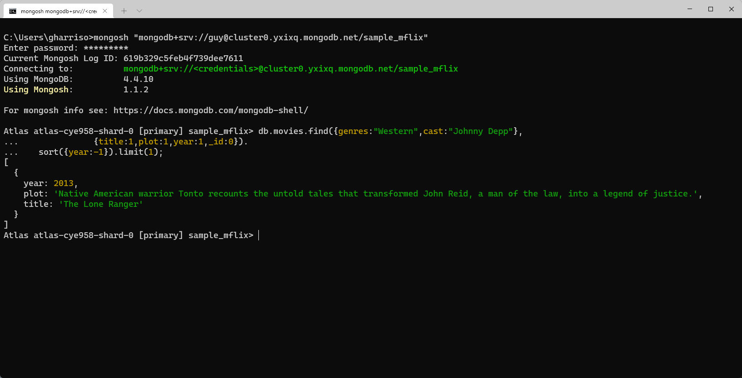

Slide 20
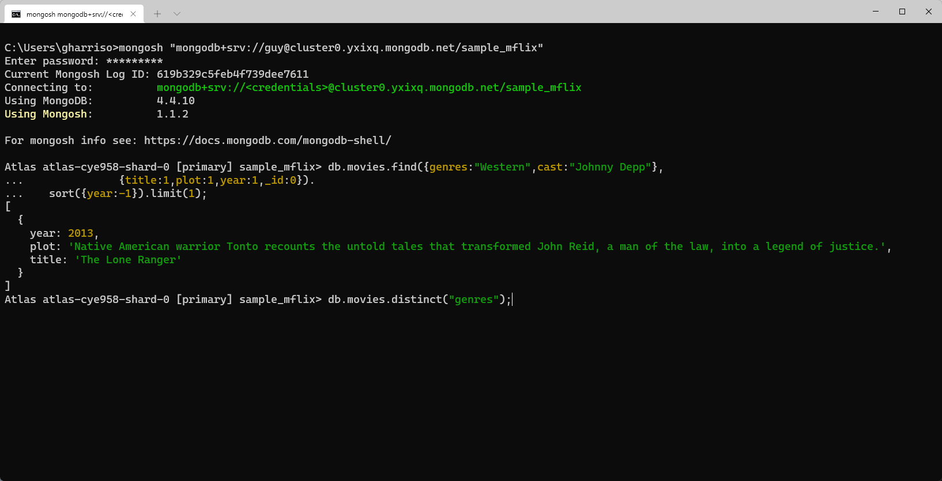

Slide 21
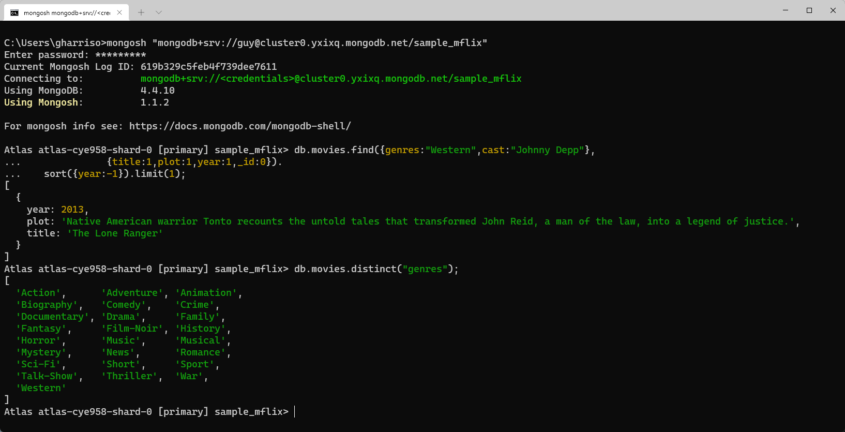

Slide 22
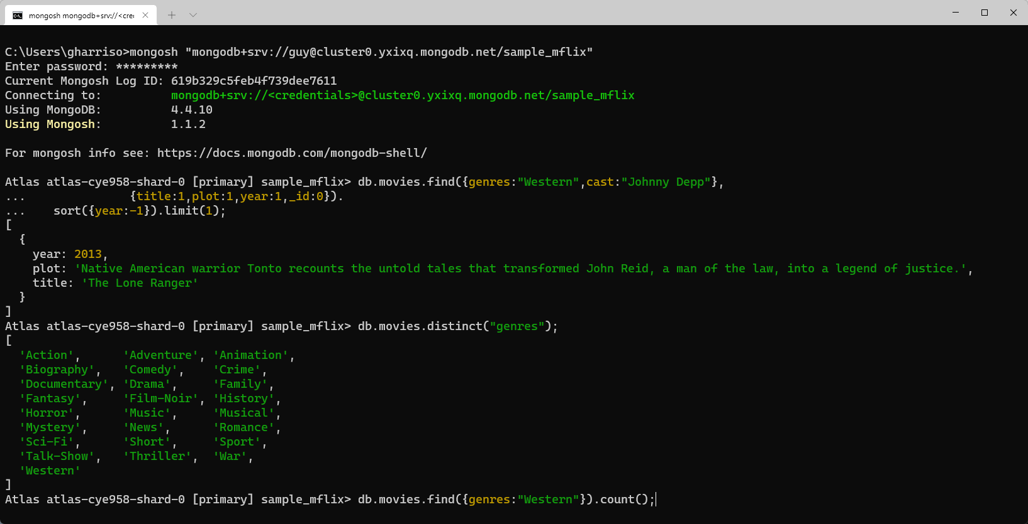

Slide 23
